Slide 1


CONSUMER GOODS AD-HOC INSIGHTS
By MANIKANTA

Slide 2
AtliQ Hardware, a fictitious corporation, distinguishes itself as a prominent computer hardware manufacturer in India with a strong global presence.
Despite its prominence, the management acknowledges the necessity for more timely and well-informed decisions supported by data insights.
A strategic initiative is underway to strengthen the data analytics team through the recruitment of junior data analysts.
To thoroughly assess potential candidates, Tony Sharma, the Director of Data Analytics, intends to orchestrate an SQL challenge, gauging both technical skills and soft skills.
The company has identified 10 specific ad hoc requests for which they are seeking valuable insights.

Slide 3
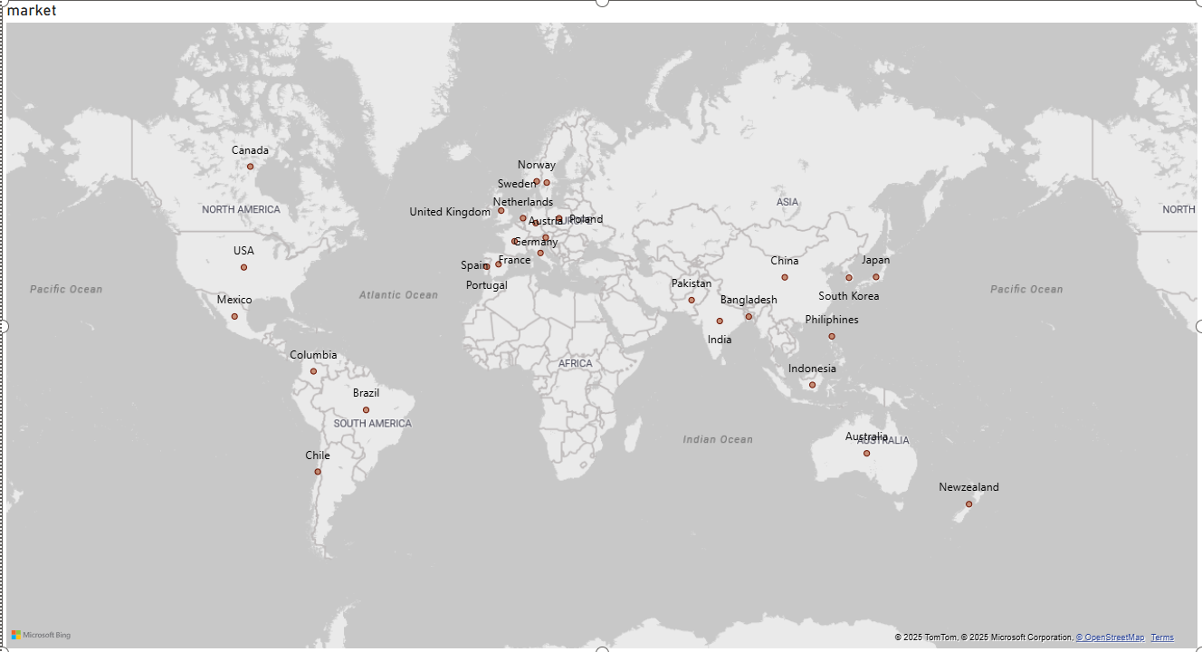
ATLIQ’S MARKETS

Slide 4
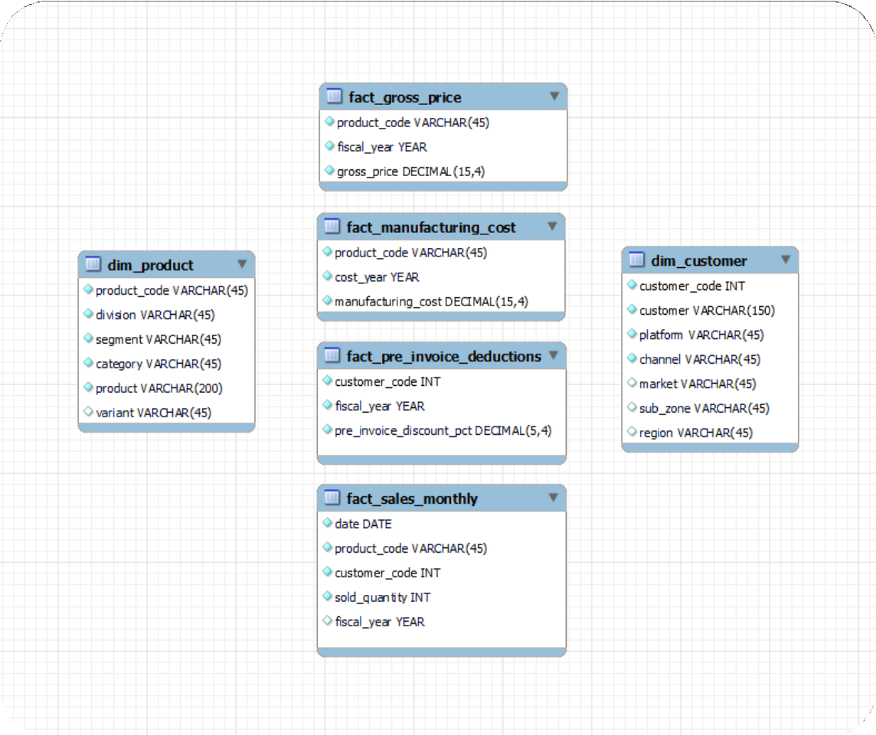
INPUT DATA

Slide 5
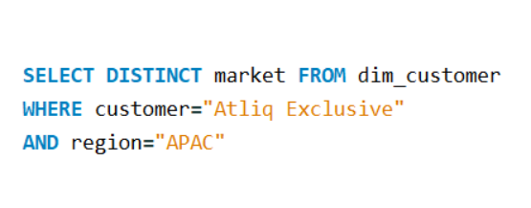
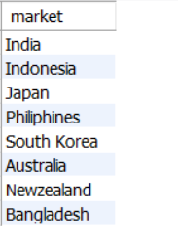

Provide the list of markets in which customer "AtliQ Exclusive" operates its business in the
“APAC” region
SQL QUERY
OUT PUT
Our “AtliQ Exclusive” store has successfully established its footprint in 8 key markets within the APAC region.

Slide 6
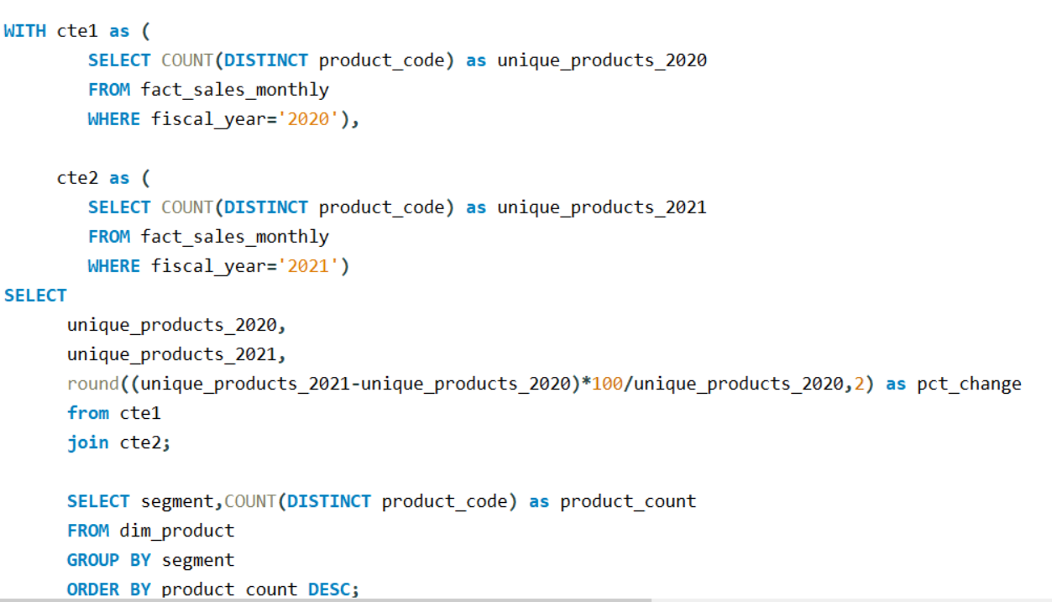
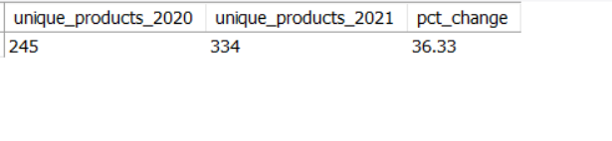
=> What is the percentage of unique product increase in 2021 vs. 2020? The final output contains these fields, unique_products_2020 unique_products_2021 percentage change
SQL QUERY
OUT PUT

Slide 7
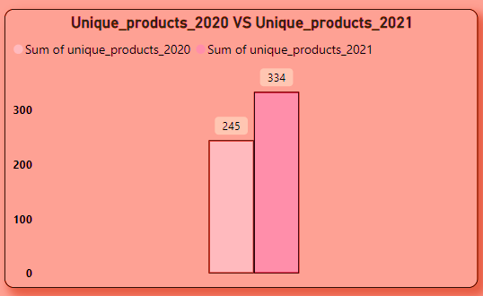
CONVERSION OF OUTPUT TO VISUAL AND INSIGHTS
We're positively demonstrating ongoing innovation, introducing new products consistently. In FY 2020, we had 245 products, but in FY 2021, the count surged by 36% to reach 334 products.

Slide 8
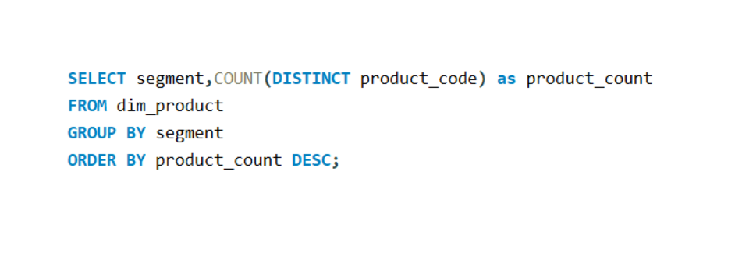
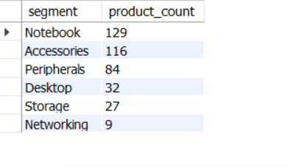
Provide a report with all the unique product counts for each segment and sort them in descending order of product
counts. The final output contains 2 fields, segment , product count
SQL QUERY
OUT PUT

Slide 9
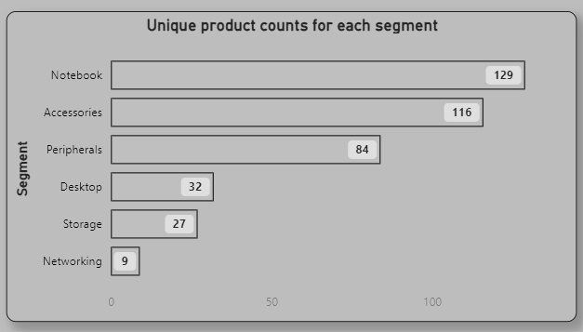
CONVERSION OF OUTPUT TO VISUAL AND INSIGHTS
Segments such as notebooks, accessories, and peripherals are experiencing notable manufacturing expansion when contrasted with desktops, storage, and networking.
Notebooks, accessories, and peripherals make up 83% of the total manufactured products.

Slide 10
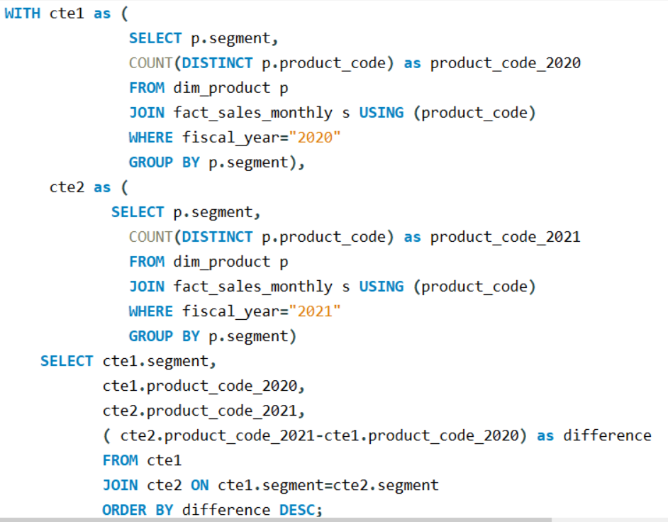
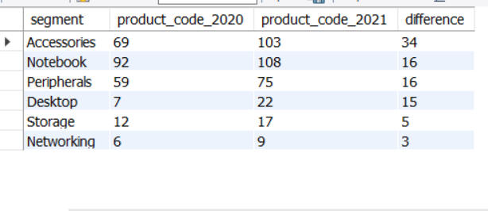
Follow-up: Which segment had the most increase in unique products in 2021 vs 2020? The final output contains these
fields, segment product_count_2020 product_count_2021, difference
SQL QUERY
OUT PUT

Slide 11
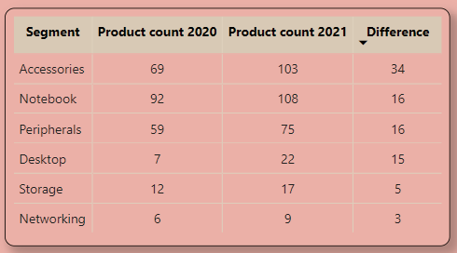
CONVERSION OF OUTPUT TO VISUAL AND INSIGHTS
Accessories saw the most significant rise in production.
Storage and networking are undergoing slower growth compared to other segments.

Slide 12
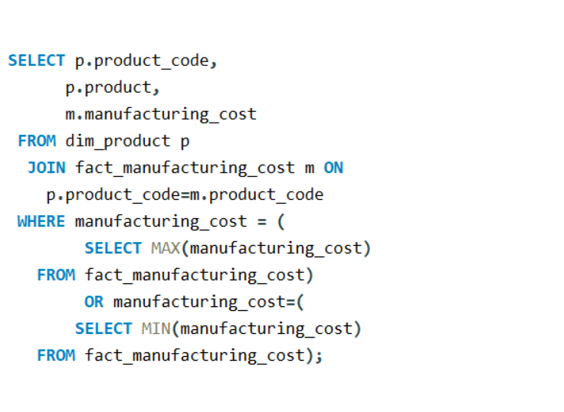
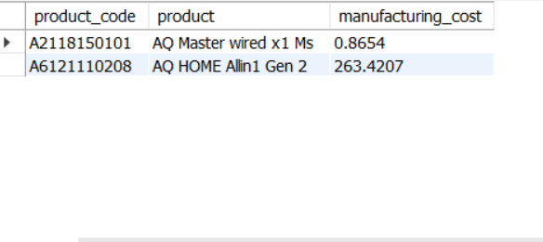
Get the products that have the highest and lowest manufacturing costs. The final output should contain these fields, product code, product manufacturing cost
SQL QUERY
OUT PUT
The AQ Home Allin1 Gen2 (Variant: Plus 3)
Personal desktop has the highest
manufacturing cost.
The AQ Master wired x1 MS (Variant: Standard 1)
Mouse incurs the lowest manufacturing cost.

Slide 13
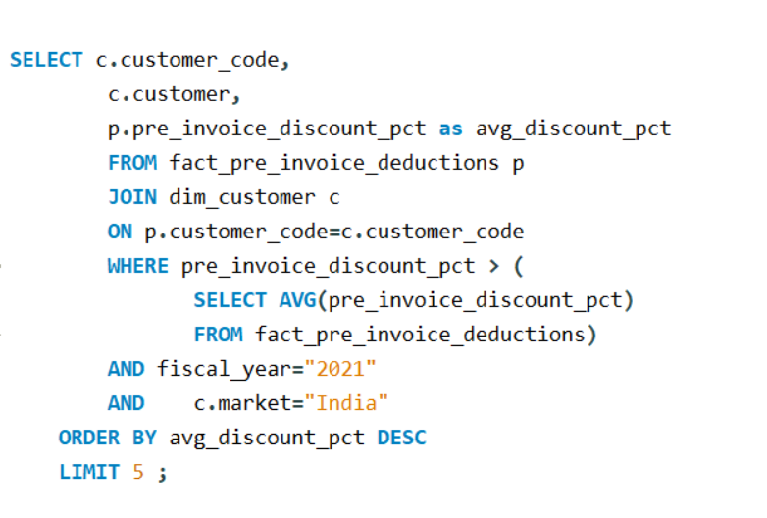
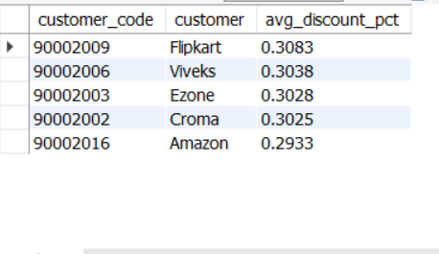
Generate a report which contains the top 5 customers who received an average high pre_invoice_discount_pct for the
fiscal year 2021 and in the Indian market, The final output contains these fields, customer_code, customer average_discount_percentage
SQL QUERY
OUT PUT

Slide 14
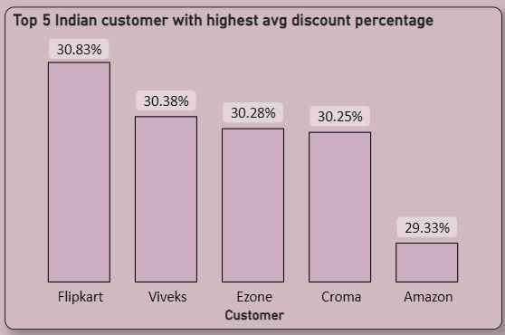
CONVERSION OF OUTPUT TO VISUAL AND INSIGHTS
Flipkart received the highest average pre-invoice discount.
Amazon received the lowest average pre-invoice discount.

Slide 15
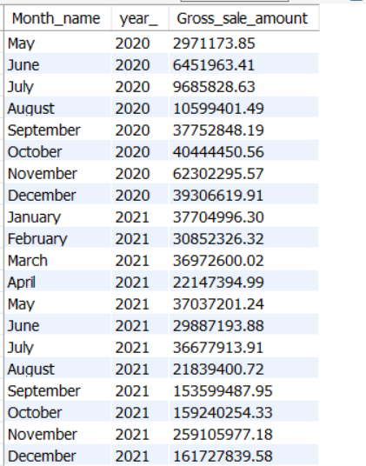
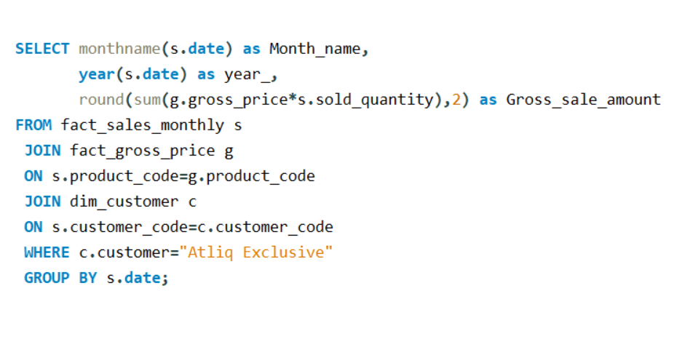
Get the complete report of the Gross sales amount for the customer “AtliQ Exclusive” for each month. This analysis helps to get an idea of low and high-performing months and make strategic decisions. The final report contains these columns: Month, Year, Gross sales Amount
SQL QUERY

Slide 16
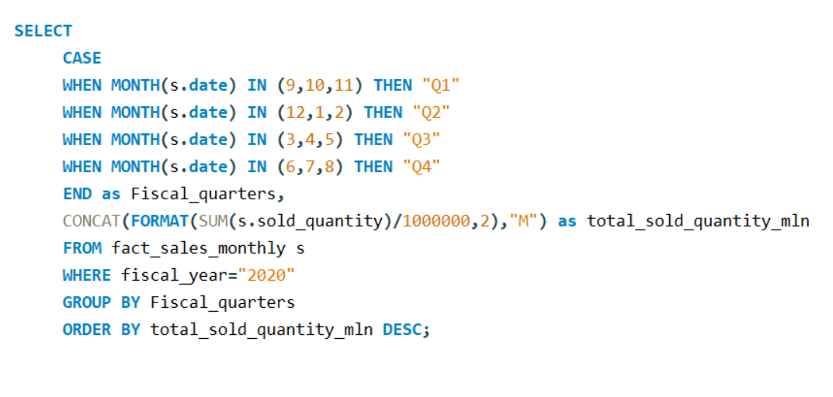
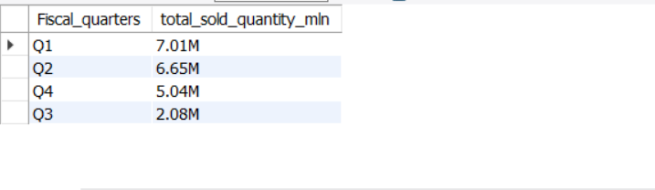
In which quarter of 2020, get the maximum total sold quantity? The final output contains these fields sorted by the
total sold quantity, Quarter , total sold quantity mln
SQL QUERY
OUT PUT

Slide 17
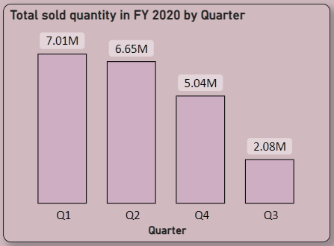
CONVERSION OF OUTPUT TO VISUAL AND INSIGHTS
The highest number of units sold across all quarters occurred in Quarter 1 of FY 2020, whereas Quarter 3 recorded the lowest sales.
Approximately 34% of the total quantity sold in FY 2020 is attributed to Quarter 1.

Slide 18
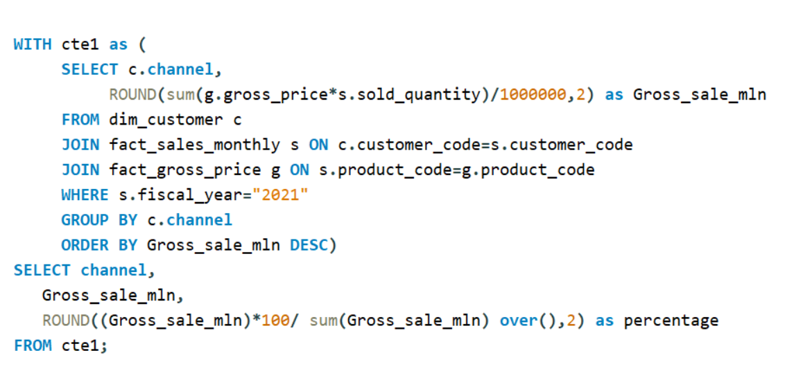
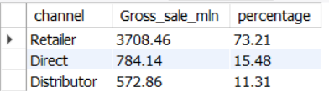
Which channel helped to bring more gross sales in the fiscal year 2021 and the percentage of contribution? The final output contains
these fields, channel, gross_sales_mln , percentage
SQL QUERY
Most of our sales occurred through Retailer, constituting 73% of the overall sales. Only a minimal portion of our sales occurred Direct and via Distributor channels.
OUT PUT

Slide 19
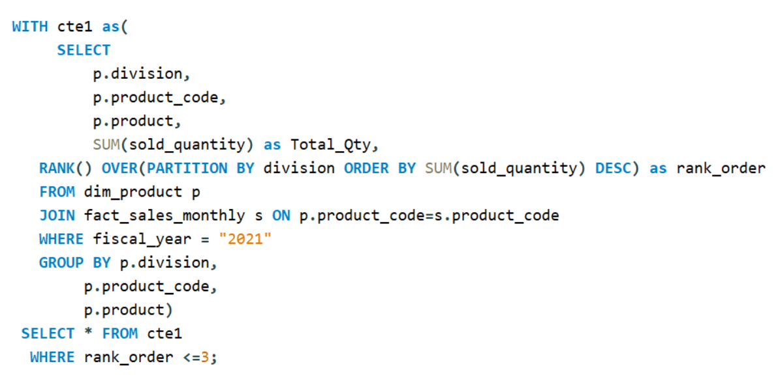
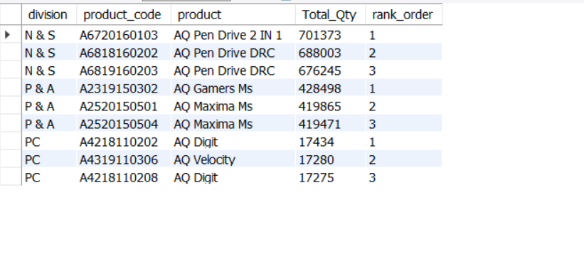
Get the Top 3 products in each division that have a high total_sold_quantity in the fiscal_year 2021? The final output
contains these fields, division , product_code , product , total_sold_quantity, rank_order
SQL QUERY
OUT PUT

Slide 20
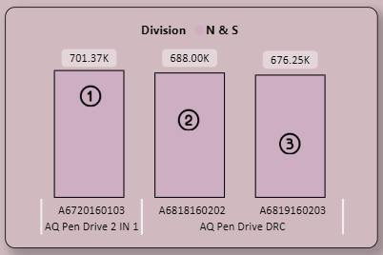
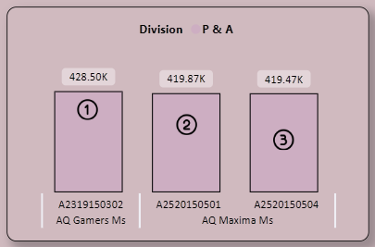
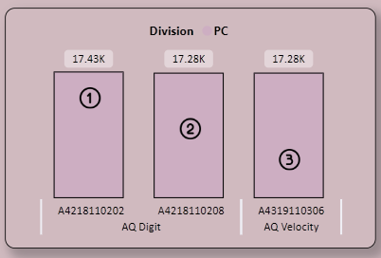
CONVERSION OF OUTPUT TO VISUAL AND INSIGHTS
The leading three products in N & S were Pen drives, with a total quantity sold of approximately 700,000 units.
The leading three products in P & A were Mouse, with a total quantity sold of approximately 400,000 units.
The leading three products in P & C were Personal Laptops, with a total quantity sold of approximately 17,000 units.

Slide 21


